Slide 1
Time-Constrained Flooding
Mehta and E. Wagner

Slide 2
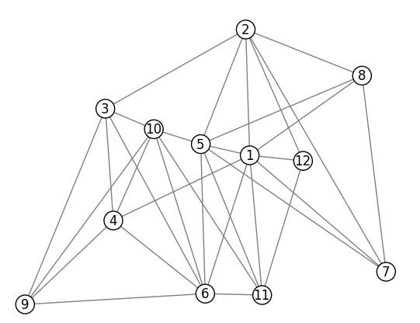
Time-Constrained Flooding: Problem Definition
Devise an algorithm that provides a subgraph containing all possible paths from source to destination with total edge latency at most L, whose nodes are all on some simple path from source to destination.
An example input.

Slide 3
Two-Step Algorithm
Phase 1: Eliminate all edges that are not on paths within maximum total latency L.
Phase 2: Remove all nodes that are not on at least one simple path from source to destination within the time constraint.
Why do we only care about nodes on simple paths?
A given node will only send packets once. If it receives the same packet twice, it will not resend it. Since non-simple paths reuse a node, they do not add reliability.

Slide 4
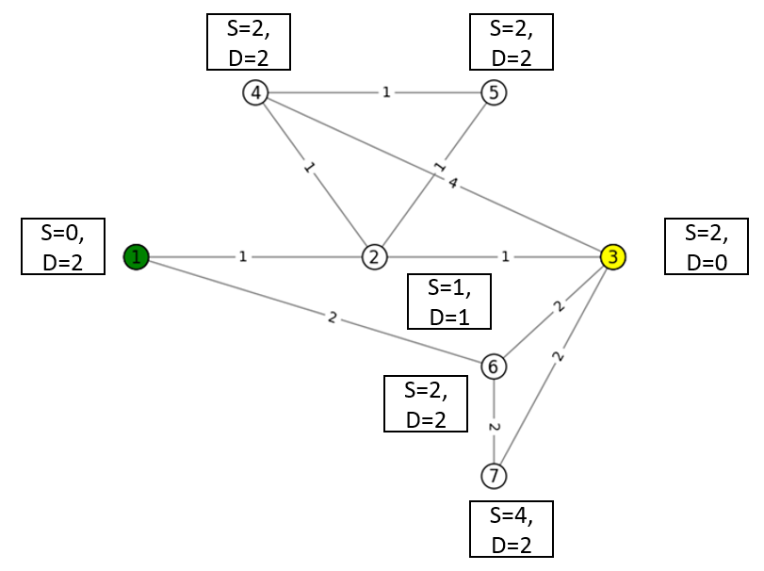
Algorithm - Phase 1
Step 1: Run Dijkstra’s algorithm once from the source and once from the destination to get the shortest distance to the source (d_{s}) and to the destination (d_{d}) for each node in the graph.
Fig : After Step 1.

Slide 5
Algorithm - Phase 1
Step 2: For each edge e in the graph check if the following condition is true:
If so, the edge is included. Otherwise, it is not.
Fig : Output after Step 2 for Budget = 5.

Slide 6
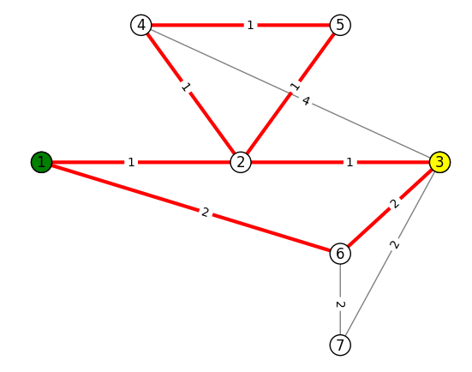
Algorithm
Now we have all edges that meet our time constraint.
However, these may include cycles that do not increase reliability.
Fig : Output after Steps 1 and 2 includes a cycle.

Slide 7
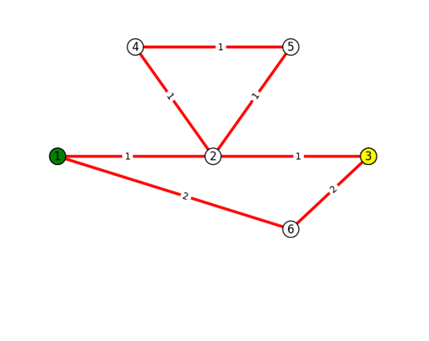
Algorithm - Phase 2
Step 1: Add a dummy node (D) to the graph with zero-latency edges to the source and destination. Add all the nodes in the graph except the source and the destination to a list of nodes called list_eval.
D
Fig : Output after Steps 1 and 2 includes a cycle.

Slide 8
Algorithm - Phase 2
Step 2: For each node(n) in list_eval, use Suurballe’s algorithm to find 2 node-disjoint paths whose total latency is minimized from n to d. 2 such paths may not exist.
If 2 node disjoint paths do not exist, remove the node from the final graph and continue from Step 2. Otherwise go to Step 3.
D
Fig : Step 2 for node 4.

Slide 9
Algorithm - Phase 2
Step 2: For each node(n) in list_eval, use Suurballe’s algorithm to find 2 node-disjoint paths whose total latency is minimized from n to d. 2 such paths may not exist.
If 2 node disjoint paths do not exist, remove the node from the final graph and continue from Step 2. Otherwise go to Step 3.
D
Fig : Step 2 for node 2.

Slide 10
Algorithm - Phase 2
Step 3: Check if the total latency of the paths obtained in Step 2, which is necessarily minimal, is within the time constraint.
If so, remove all the nodes on either path from list_eval, as these are all known to be on a valid simple path from source to destination. Otherwise, remove the node from the final graph. Repeat from Step 2 until list_eval is empty.
D
Fig : Step 2 for node 2.

Slide 11
Algorithm - Phase 2
Step 3: Check if the total latency of the paths obtained in Step 2, which is necessarily minimal, is within the time constraint.
If so, remove all the nodes on either path from list_eval, as these are all known to be on a valid simple path from source to destination. Otherwise, remove the node from the final graph. Repeat from Step 2 until list_eval is empty.
Fig : Final Output for Budget = 5.

Slide 12
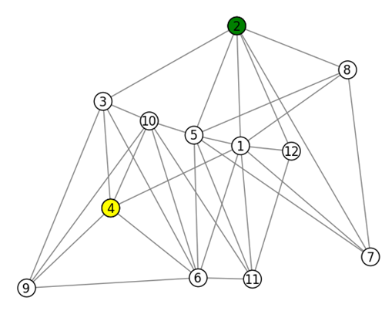
Example Graph: Practical Topology
With source node 2, destination node 4, and a budget b = 34.75 ms, no paths are possible.

Slide 13
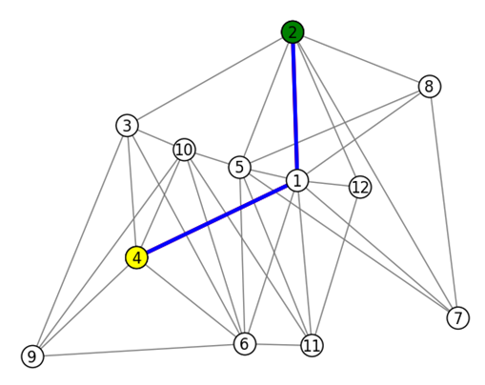
Example Graph: Practical Topology
At b = 35 ms, a single path appears.

Slide 14
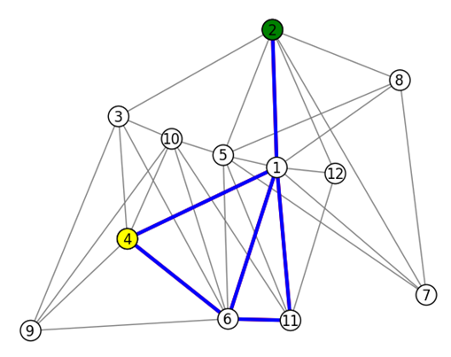
Example Graph: Practical Topology
No further changes until b = 36 ms.

Slide 15
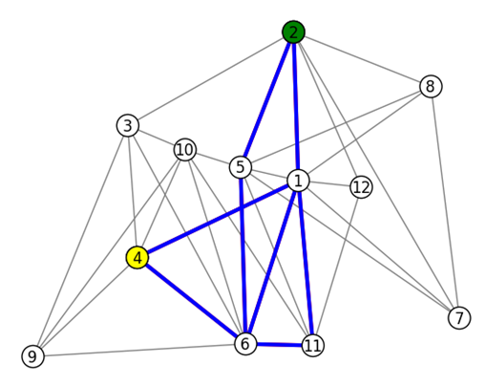
Example Graph: Practical Topology
At b = 36.25 ms.

Slide 16
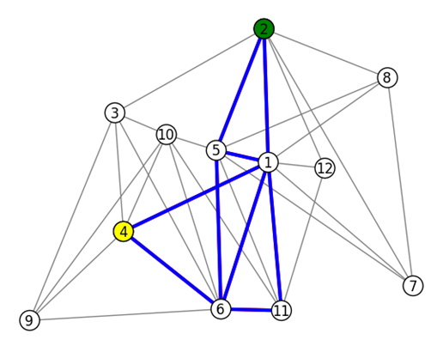
Example Graph: Practical Topology
At b = 36.75 ms.

Slide 17
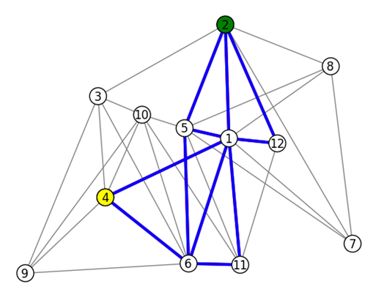
Example Graph: Practical Topology
At b = 37.25 ms.

Slide 18
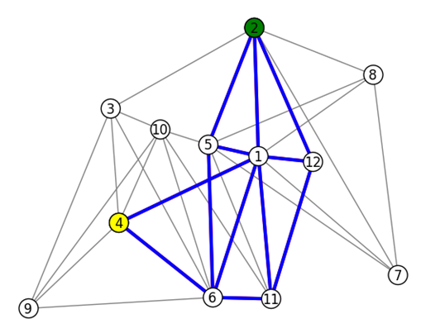
Example Graph: Practical Topology
At b = 38 ms.

Slide 19
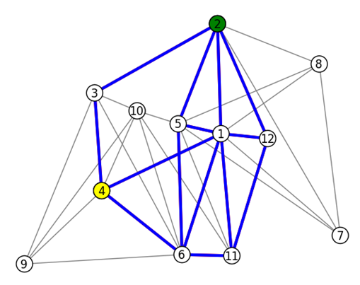
Example Graph: Practical Topology
At b = 38.5 ms.

Slide 20
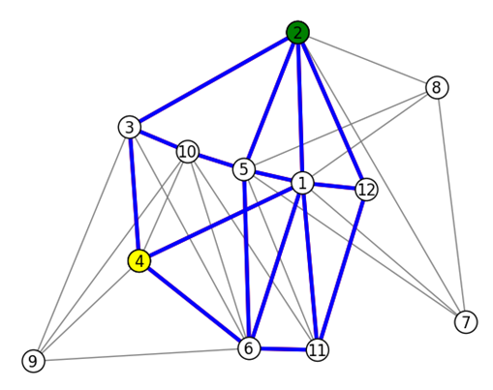
Example Graph: Practical Topology
At b = 40.25 ms.

Slide 21
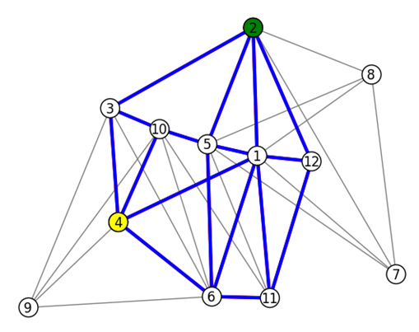
Example Graph: Practical Topology
At b = 41.25 ms.

Slide 22
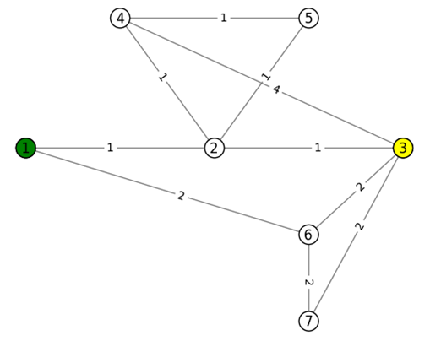
Example Graph: Loop Graph
This graph will show the full power of algorithm that removes nodes only on non-simple paths from the source, node 1, to the destination, node 3.

Slide 23
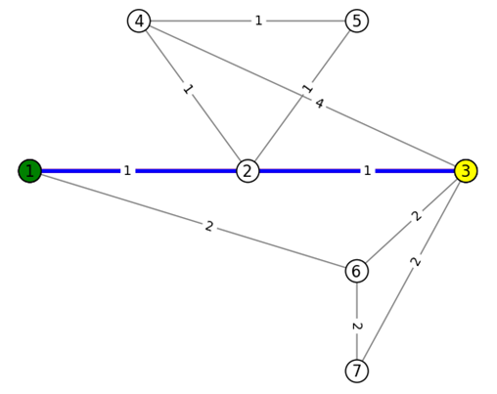
Example Graph: Loop Graph
The first path appears at b = 2.

Slide 24
Example Graph: Loop Graph
At b = 3.

Slide 25
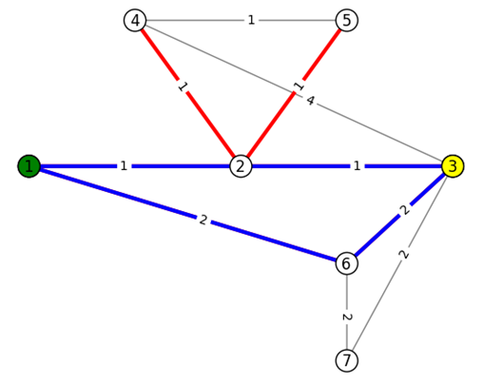
Example Graph: Loop Graph
The first node removals happen at b = 4. They are shown in red. The bottleneck at node 2 precludes the existence of 2 node-disjoint paths.

Slide 26
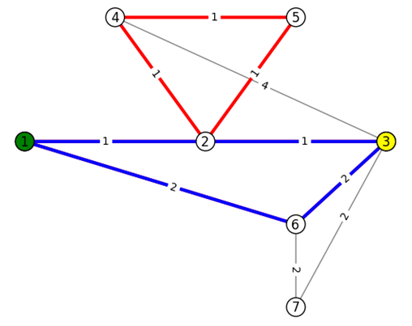
Example Graph: Loop Graph
An additional edge is within the time constraint at b = 5, but is removed due to the same bottleneck.

Slide 27
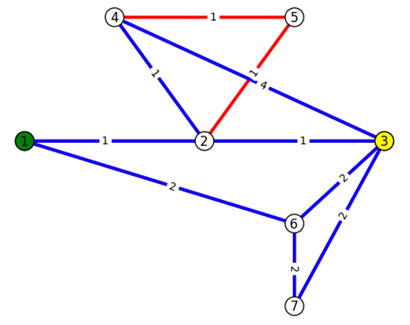
Example Graph: Loop Graph
At b = 6, the edge between 4 and 3 is now within the budget on the path 1-2-4-3, so there is no longer a bottleneck at node 2 for node 4.

Slide 28
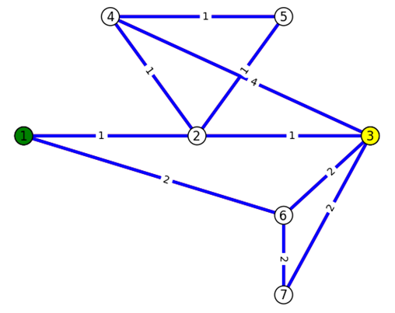
Example Graph: Loop Graph
At b = 7, the path 1-2-5-4-3 is now in the budget, so all nodes are now on some simple path from source to destination within the budget.

Slide 29
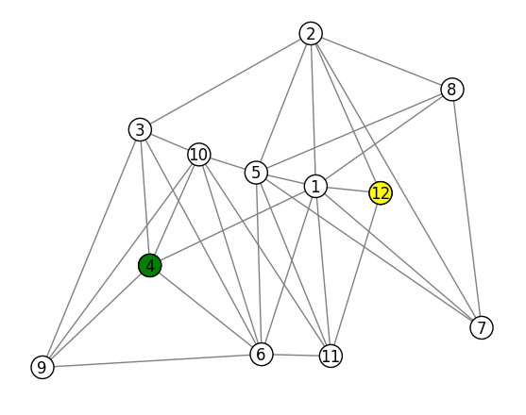
Demonstration: Subgraph Reachability
When increased latency budget results in more edges in the subgraph, more nodes can fail without breaking s-t reachability.
Small latency budget increases can result in large increases in the number of edges within the time constraint.
Live demo on practical network topology from west coast to JHU.

Slide 30
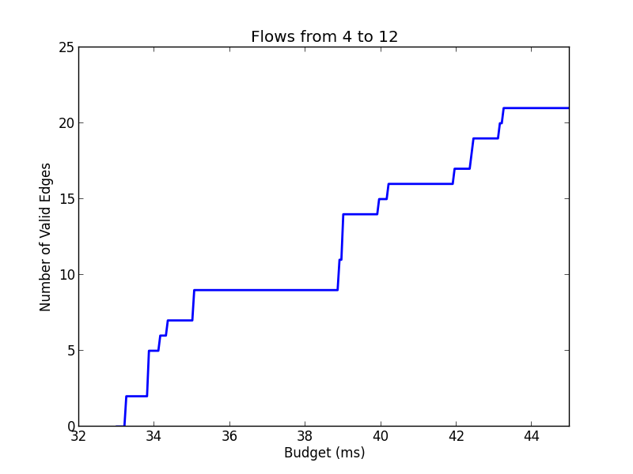
Demonstration: Subgraph Reachability

Slide 31
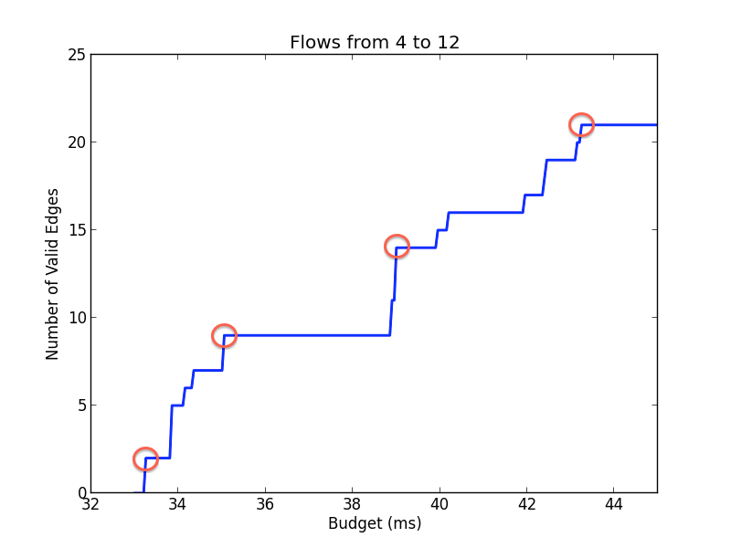
Demonstration: Subgraph Reachability
b₁ = 33.75 ms
b₂ = 35.05 ms
b₃ = 39.0 ms
b₄ = 43.25 ms

Slide 32
Applications of Time-Constrained Flooding
Using packets sent over time-constrained flooding graphs, we can get an upper bound on reliability for a given source, destination, and time budget.
The smallest latency for which a path is found with this algorithm can be used to determine the minimum bandwidth cost and the resulting reliability for a given source and destination.
Thus for a given s-t pair, we can get a lower bound on cost and latency and find the associated reliability, and an upper bound on reliability at a given budget.

